Slide 1
Introduction to Deep Learning

Slide 2
What you will (hopefully) learn:
Understand what drives AI innovations
Application (pythonic libraries: Tensorflow, scikitlearn, etc.)
ML Intuition (math, general principles of ML)

Slide 3
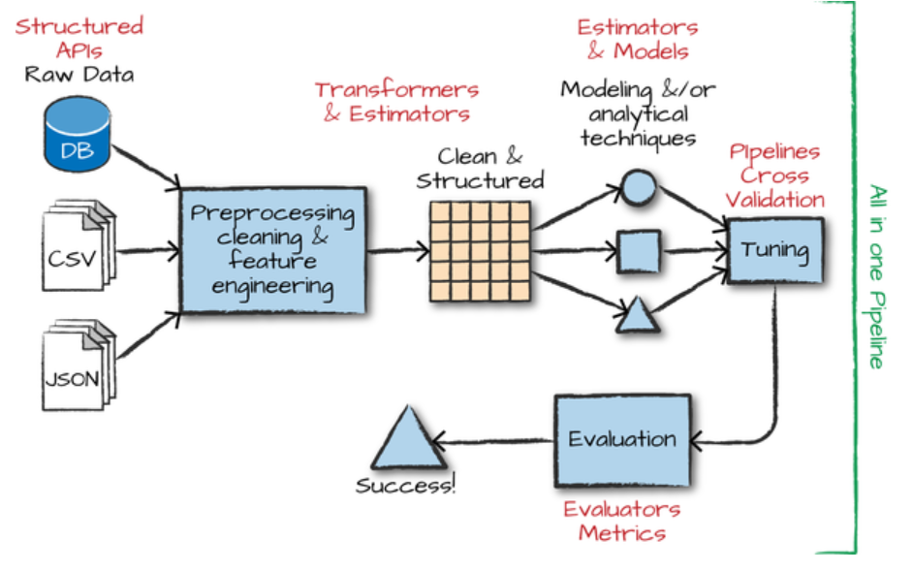

Slide 4
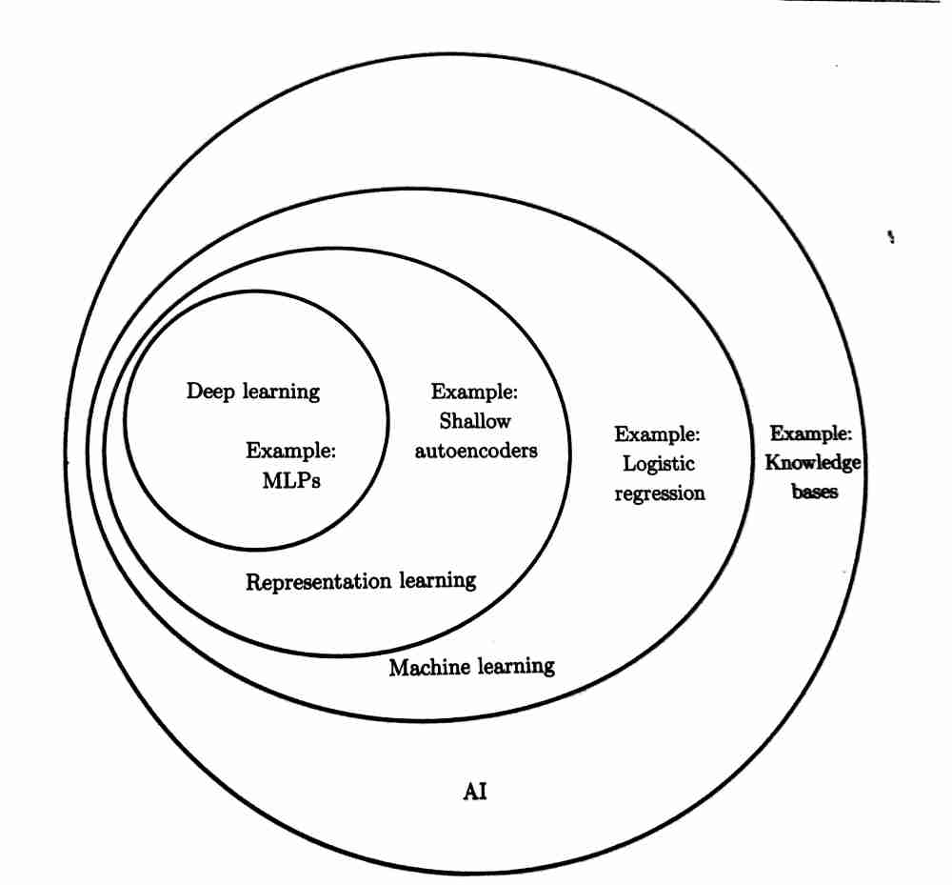

Slide 5
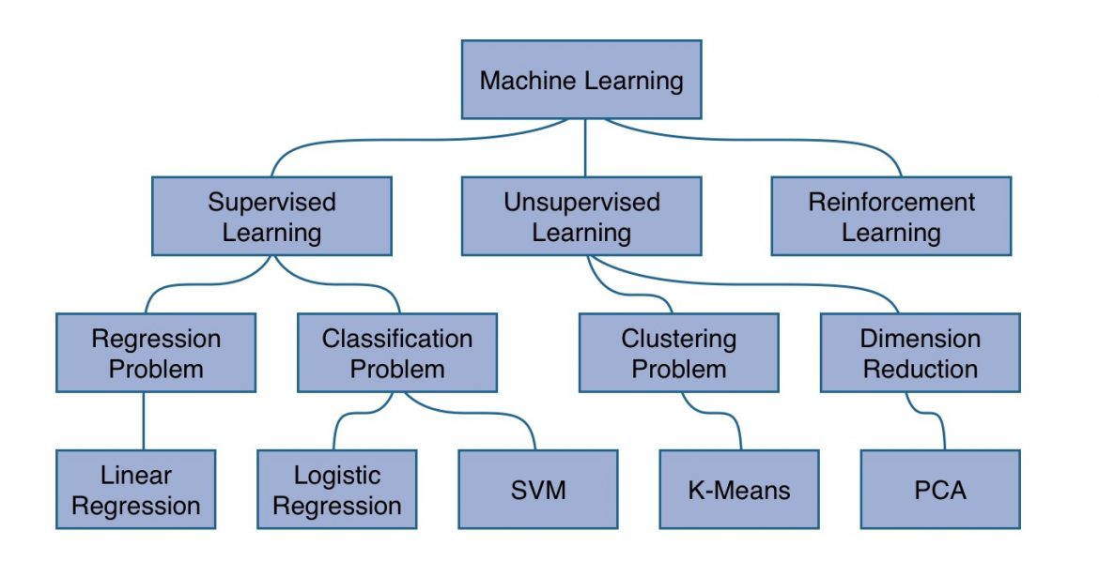
Types of machine learning

Slide 6
Recap and Reinforce: Linear regression and Logistic regression
Step 1: Determine the problem that you’re trying to solve and the approach to take: i.e. is it a regression or a classification problem?
Regression
Classification
Linear Regression
Logistic Regression

Slide 7
Step 2: Prepare the dataset (preprocessing, cleaning, visualisation, etc.)
Input: X
Labels: Y
Training set
Validation set
Test set

Slide 8
Step 3: Train the model
Training set(X)
Model(𝜃)
Hypothesis(H)
Cost Function(J)
Optimizer(O)
Linear Reg
Logistic Reg
H - Predictions that machine learning model outputs when given some input. | mx + c | sigmoid(mx + c)
J - Calculates the difference between the predictions and the actual answers (labels). Basically indicates how ‘wrong’ the model is. | Mean squared loss | Logarithmic loss
O - Updates theta by making the model internalize the cost. | Gradient descent

Slide 9
Are we done?
Goal of learning: To learn theta well enough so as to...minimize the cost function???
WRONG!!! The goal of learning is to learn theta well enough so that future predictions made on test cases can be as accurate as possible.
Step 4: Validate and test the model
Step 5: Hyperparameter tuning

Slide 10

Today: MLP (Multilayer Perceptron)
Allows for the model to map more complex functions that single layer ML models cannot map.

Slide 11
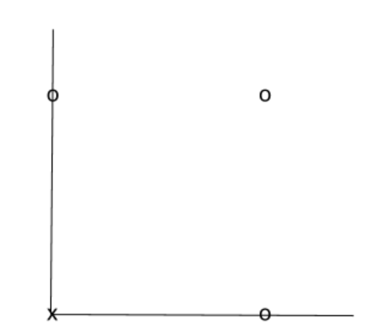
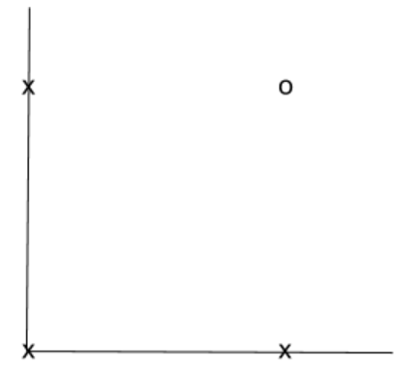
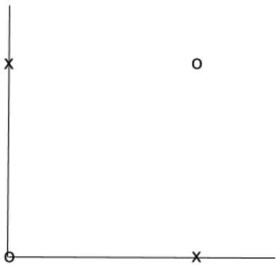
OR
AND
???
XNOR

Slide 12

Let’s try to construct a XNOR gate using a MLP!
We will use the sigmoid function, where:
Taking 𝜃1 = [ -30, 20, 20], i.e. h(x) = g(-30+20X₁ +20X₂ ),
0 | 0 | ~0
1 | 0 | ~0
0 | 1 | ~0
1 | 1 | ~1
𝜃1 can be used to represent a AND gate!

Slide 13
Likewise…
𝜃2 = [-10, 20, 20] can represent a OR gate.
𝜃3 = [10, -20, -20] can represent a NOR gate.
X1 | X2 | A1(X1 AND X2) | A2(X1 NOR X2) | H (A1 OR A2)
0 | 0 | 0 | 1 | 1
1 | 0 | 0 | 0 | 0
0 | 1 | 0 | 0 | 0
1 | 1 | 1 | 0 | 1

Slide 14
+1
+1
-30
-10
X1
A1
H
20
20
10
-20
20
20
X2
A2
-20
Notes:
https://youtu.be/aircAruvnKk
https://medium.com/@jayeshbahire/perceptron-and-backpropagation-970d752f4e44
https://medium.com/@tiago.tmleite/neural-networks-multilayer-perceptron-and-the-backpropagation-algorithm-a5cd5b904fde

Slide 15
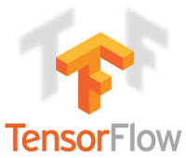
Introduction to Tensorflow
Open source framework for developing machine learning models and algorithms, most notably neural networks.
How do we picture tensorflow? Basis of tensorflow is a dataflow graph.
Graphs consist of 2 main parts: nodes and edges. Nodes represent mathematical operations, while edges represent multidimensional arrays/tensors.

Slide 16
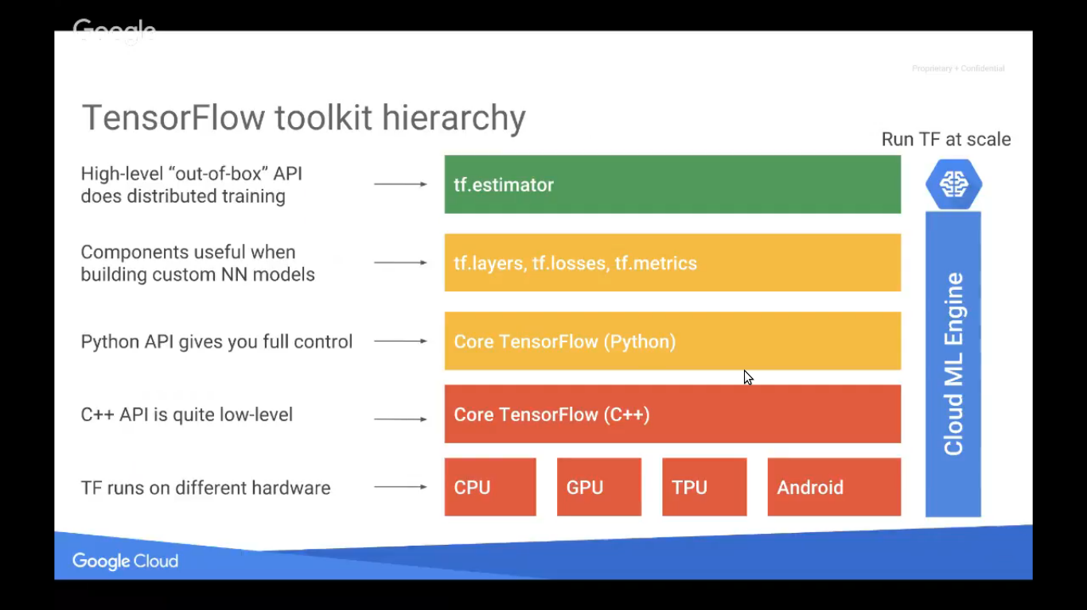
(Keras)
Notes:
https://www.tensorflow.org/api_docs/python/

Slide 17
PRACTICE!

Slide 18
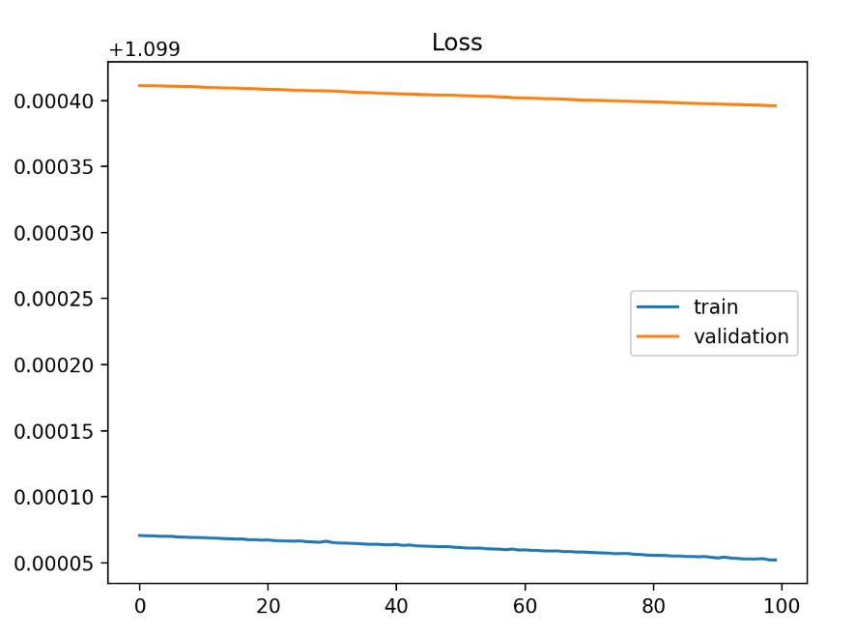
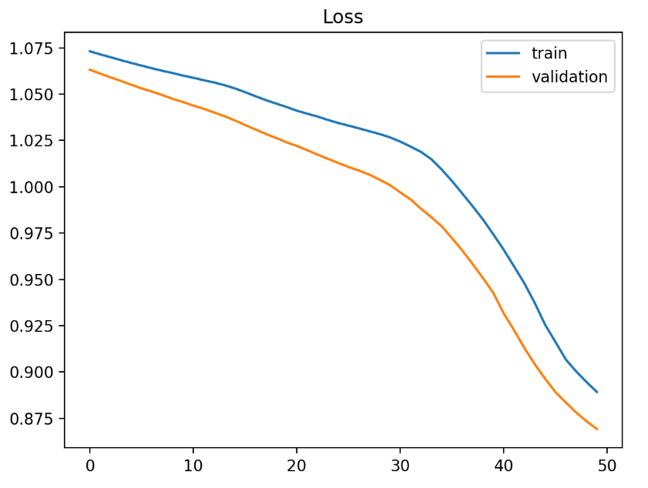
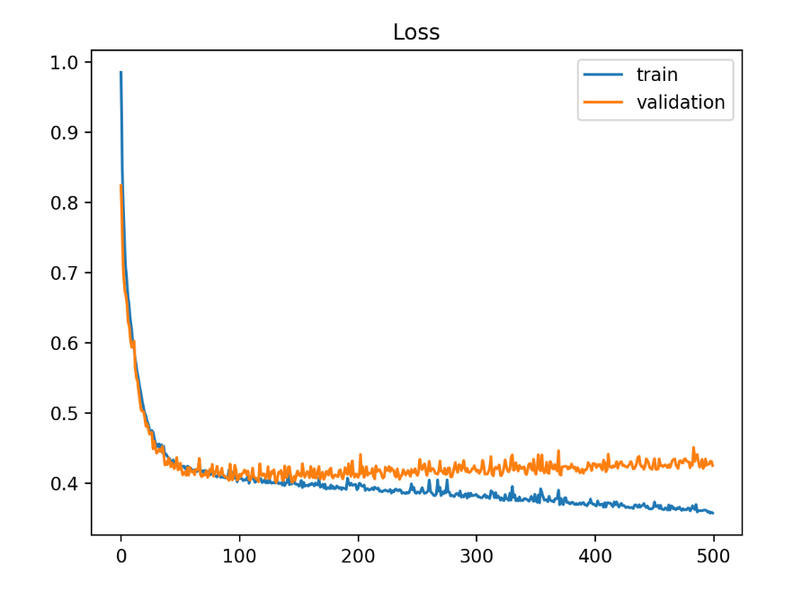
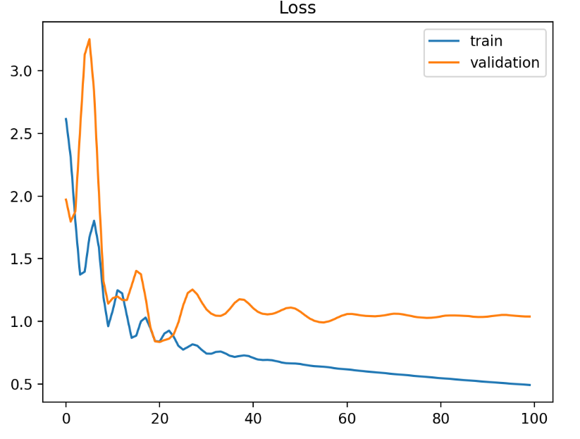
Cost curves: Good fit or not?
Notes:
Top left and right: underfit
Bottom left: overfit
Bottom right: unrepresentative training set

Slide 19
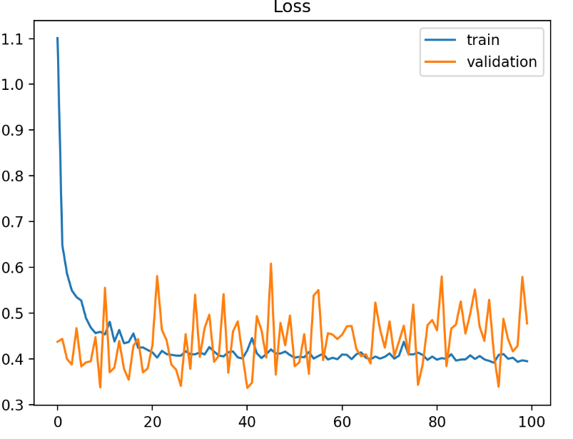
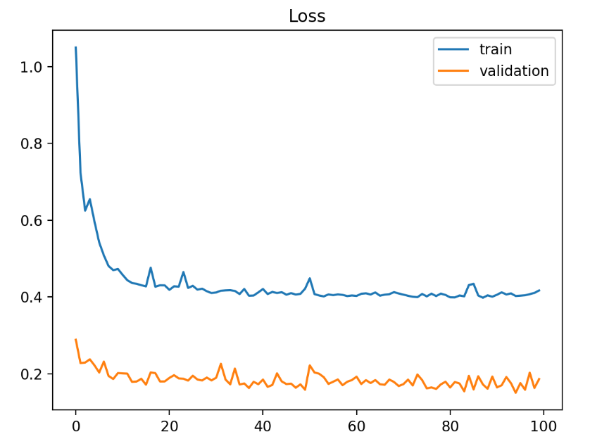
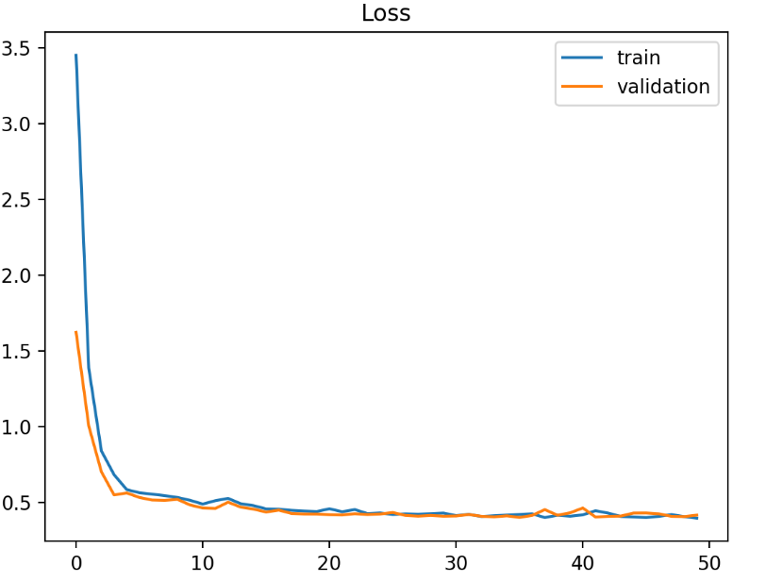
Cost curves: Good fit or not?
Notes:
Top left and right: unrepresentative validation sets
Bottom: good fit

Slide 20
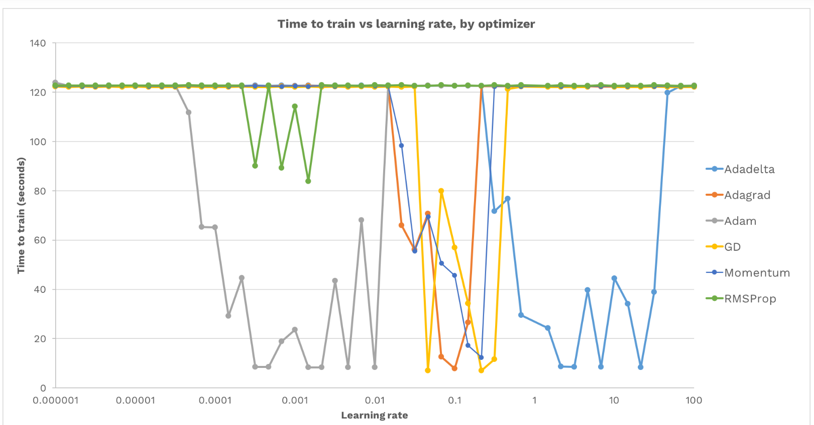
Notes:
https://medium.com/octavian-ai/which-optimizer-and-learning-rate-should-i-use-for-deep-learning-5acb418f9b2

Slide 21


Slide 22
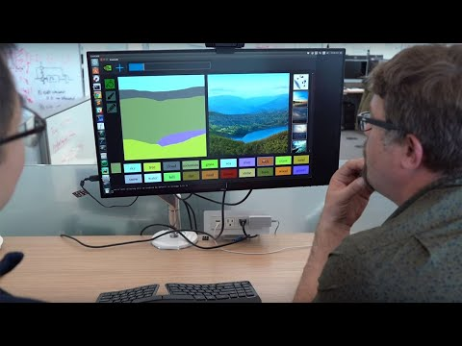
GANs - How do they work?
Notes:
https://pathmind.com/wiki/generative-adversarial-network-gan
https://github.com/nashory/gans-awesome-applications

